Slide 1
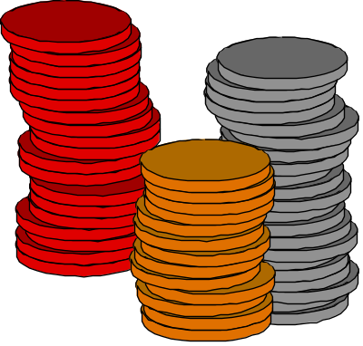
What is a stack?
Stores a set of elements in a particular order
Stack principle: LAST IN FIRST OUT
= LIFO
It means: the last element inserted is the first one to be removed
Example
Which is the first element to pick up?

Slide 2
Last In First Out
B
A
C
B
A
D
C
B
A
E
D
C
B
A
top
D
C
B
A
top
top
top
A
top

Slide 3

Stack Applications
Real life
  Pile of books
  Plate trays
More applications related to computer science
  Program execution stack (read more from your text)
  Evaluating expressions

Slide 4
Array-based Stack Implementation
Allocate an array of some size (pre-defined)
  Maximum N elements in stack (0 to size-1)
Bottom stack element stored at element 0
last index in the array is the top i.e size-1
Increment top when one element is pushed, decrement after pop

Slide 5
Primitive operations on stack:
Insertion operation
Add a new item onto top of stack. (push)
Deletion operation
Delete item from top of stack. (pop)

Slide 6
Stack Implementation:
PUSH,POP
PUSH
1. if top==size-1 i.e stack full. Then it prints message the stack is full and no element can be added onto it.
2. otherwise, increments top by 1 and inserts item onto stack.

Slide 7
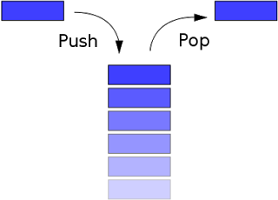
Stack Operations:

Slide 8
Definition:
##define SIZE 5
int stack[SIZE];
int top=-1;
empty()
{
if(top ==-1)
return(1);
}
Full( )
{
if(top==size-1)
return(1);
}
4
4
50
3
3
40
2
2
30
1
1
20
0
0
10

Slide 9
Procedure push(S, top, size, item)
{
/*check for overflow*/ if (top >size) print “ Stack Overflow” return other wise,
/* increment top */ top = top+1
/*insert the item into stack */
S[top]=item return;
}
Push

Slide 10
POP
POP
1. if top== -1 i.e. stack is empty, it prints an error message indicating that no elements present in stack.
2. Otherwise, removes the top element from the stack. Returns this element to the calling program and decrements the top by 1

Slide 11
procedure pop(S, top)
{
/* return the top element from the stack */ if (top == -1) then print “Stack underflow” return;
/* retrieve the top element */ item = S[top]
/* decrement top */ top = top – 1
/* return top element */ return item;
}
Pop

Slide 12
Applications of stack
Stacks are used in conversion of expression from infix notation to postfix and prefix notation.
Stack are used for evaluation of infix and postfix forms.
Stacks are used in tree traversal techniques.
Recursive functions are implemented using stacks.

Slide 13
Compilers use stacks in syntax analysis phase to check whether a particular statement in a program is syntactically correct or not.
Computers use stack during interrupts and function calls. The information regarding actual parameters return values, return addresses and machine status is stored in stack.
Stacks are used in depth first search of a graph.

Slide 14
Algorithm Analysis
push O(?)
pop O(?)
isEmpty O(?)
isFull O(?)
What if top is stored at the beginning of the array?

Slide 15
A Legend
The Towers of Hanoi
In the great temple of Brahma in Benares, on a brass plate under the dome that marks the center of the world, there are 64 disks of pure gold that the priests carry one at a time between these diamond needles according to Brahma's immutable law: No disk may be placed on a smaller disk. In the begging of the world all 64 disks formed the Tower of Brahma on one needle. Now, however, the process of transfer of the tower from one needle to another is in mid course. When the last disk is finally in place, once again forming the Tower of Brahma but on a different needle, then will come the end of the world and all will turn to dust.

Slide 16


The Towers of Hanoi
A Stack-based Application
  GIVEN: three poles
  a set of discs on the first pole, discs of different sizes, the smallest discs at the top
  GOAL: move all the discs from the left pole to the right one.
  CONDITIONS: only one disc may be moved at a time.
  A disc can be placed either on an empty pole or on top of a larger disc.

Slide 17
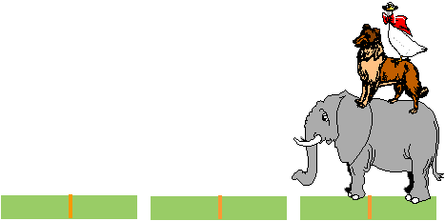
Towers of Hanoi

Slide 18
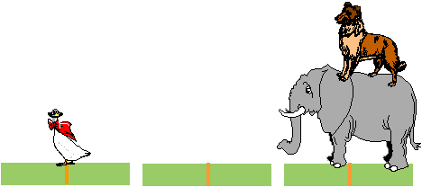
Towers of Hanoi

Slide 19
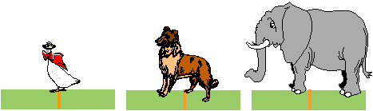
Towers of Hanoi

Slide 20

Towers of Hanoi

Slide 21

Towers of Hanoi

Slide 22
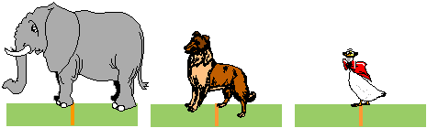
Towers of Hanoi

Slide 23
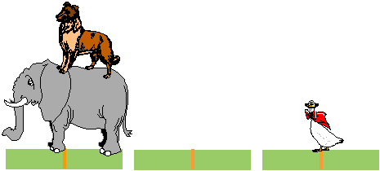
Towers of Hanoi

Slide 24
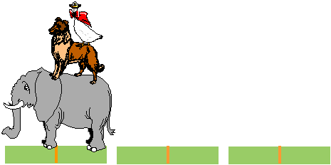
Towers of Hanoi

Slide 25
The problem is solved recursively
If N=1 move the disk from needle A to C
Move (N-1) disks from needle A to B
Move disk N from needle A to C
Move (N-1) disks from needle B to C

Slide 26
Towers of Hanoi – Recursive Solution
#include<stdio.h>
#include<conio.h>
void TOH(int num, char x, char y, char z);
main() {
int num;
printf("\nEnter number of plates:");
scanf("%d", &num);
TOH(num, 'A', 'B', 'C');
getch();
}

Slide 27
void TOH(int num, char x, char y, char z) {
if (num ==1) {
printf("Move disk %d from needle %c to %c\n",num,x,z);
return;
}
TOH(num-1,x,z,y);
printf("Move disk %d from needle %c to %c\n",num,x,z);
TOH(num - 1, y, x, z);
}

Slide 28
Is the End of the World Approaching?
Problem complexity 2^{n}
64 gold discs
Given 1 move a second
→ 600,000,000,000 years until the end of the world ☺

Slide 29
Recursion
A recursive function is defined as a function that calls itself to solve a smaller version of its task until a final call is made which does not require a call to itself.

Slide 30
#include<stdio.h>
int factorial(int);
main()
{
int n;
int f;
printf("Enter an integer to find its factorial\n");
scanf("%d", &n);
f = factorial(n);
printf("%d! = %d\n", n, f);
}
int factorial(int n)
{
if (n == 0)
return 1;
else
return(n * factorial(n-1));
}

Slide 31
You are required to complete the 4 methods push1, push2 which takes one argument an integer 'x' to be pushed into stack one and two and pop1, pop2 which returns the integer poped out from stack one and two. If no integer is present in the array return -1.

Slide 32
push1(2) the stack1 will be {2} push1(3) the stack1 will be {2,3} push2(4) the stack2 will be {4} pop1() the poped element will be 3 from stack1 and stack1 will be {2} pop2() the poped element will be 4 from stack2 and now stack2 is empty pop2() the stack2 is now empty hence -1 .

Slide 33
Your task is to complete the function reverse() which takes the string S as an input parameter and returns the reversed string.

Slide 34
Find the largest rectangular area possible in a given histogram where the largest rectangle can be made of a number of contiguous bars. For simplicity, assume that all bars have the same width and the width is 1 unit, there will be N bars height of each bar will be given by the array arr.

Slide 35
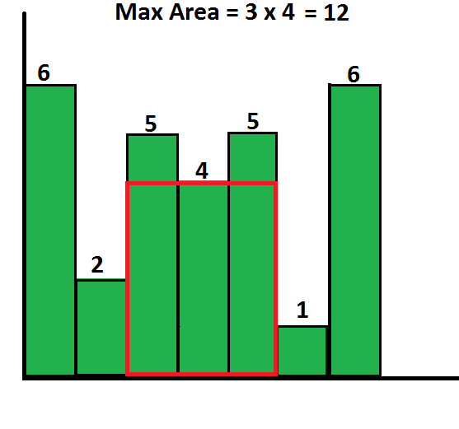
Input: N = 7 arr[] = {6,2,5,4,5,1,6} Output: 12 Explanation:

